Slide 1
We Get Results
SOUTHERN REALTY
ENTERPRISES,INC

Slide 2
We’ll Get You Top Dollar
We Create a Special Marketing Plan to Get You More Money for Your Property

Slide 3
Save More Dollars !!!
National Moving Discounts
FREE Home Security System
Wholesale prices on Flooring,Cabinets and Countertops
Discounts on New Appliances
Save on Repairs with our Vendors
FREE Interior Design Consultation
FREE Broker Price Opinions
Save Dollars with our Affiliated Lenders and Title Services

Slide 4
Commissions as low as 3%
We work hard to save you more

Slide 5
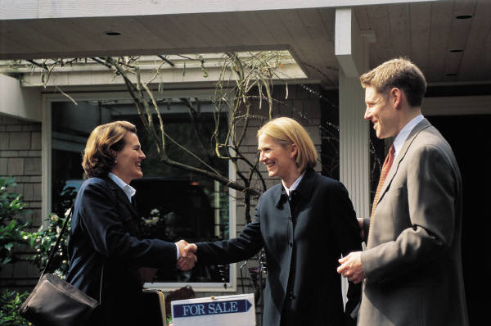
Home Warranty Programs
Make your house more valuable and saleable
Helps you compete with new homes
Coverage/Protection while you sell is available

Slide 6
Training Training Training
Our Associates Receive Top Training
Training Available 24/7
Top Level Support from Mgmt and Staff

Slide 7
Broker Price Opinions
ACCURATE & PROFESSIONAL CMAS
TOTALLY COMPUTERIZED WITH MAPPING

Slide 8
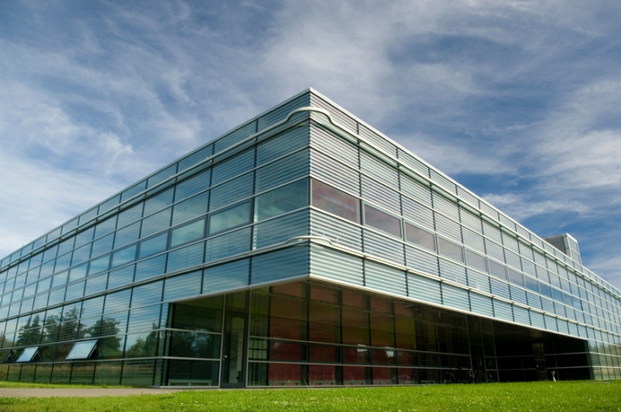
Major Corporations use our services
AT&T
WESTINGHOUSE
SUNTRUST
NORTHROP GRUMMAN
WACHOVIA
AAA
FEDERAL EXPRESS
GENERAL FOODS
LOCKHEED MARTIN
GENERAL ELECTRIC
MANY MORE

Slide 9
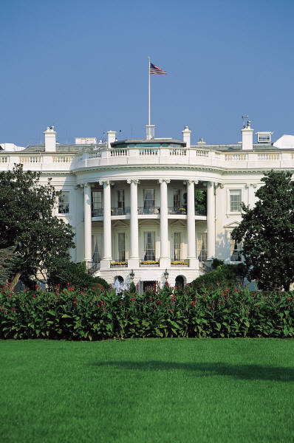
We sell for the US Government
VA - VETERANS ADMINISTRATION
FANNIE MAE & FREDDIE MAC
HUD-FHA - FEDERAL HOUSING AUTHORITY

Slide 10
Worldwide Marketing
WE BRING YOU MORE BUYERS
INTERNATIONAL MLS
WORLDWIDE BROKER NETWORK
INTERNET BUYERS & SELLERS
LISTED ON OVER 100 WEB SITES
OVER 1000 REFERRALS PER YEAR

Slide 11
Quality Flyers
Full color flyers
Full color laser printer

Slide 12
We Get the Job Done
SALES RATE
OUR AVG. IS 95 %
MLS ONLY 71 %
BASED ON 2020 ORLANDO BOARD OF REALTORS STATISTICS

Slide 13
Our Mortgage Affiliations
BENEFITS TO YOU
MORE QUALIFIED BUYERS
BETTER SERVICE
MORE LOAN APPROVALS
FLIERS,BROKER OPEN HOUSES
NO POINT LOANS

Slide 14
Our Title Companies
BENEFITS TO YOU
BETTER SERVICE
FASTER CLOSINGS
DISCOUNTED FEES

Slide 15
Free Short Sale Processing
We have companies to process your Short Sales with no cost to you or your Buyer

Slide 16
Great Advertising
YOUR PROPERTY IS ADVERTISED EVERY DAY UNTIL SOLD
Zillow,Trulia,Realtor.com,Redfin and many more
ORLANDO SENTINEL
HOMES & LAND
TREASURE CHEST
WALL STREET
NEW YORK TIMES
DIRECT MAIL OUTS
UNIQUE HOMES MAGAZINE
LA PRENSA
OUT OF STATE PUBLICATIONS

Slide 17
High Tech Advertising
RADIO ADVERTISING
We bring more buyers with our " TALKING HOUSES "
Virtual Tours
DREAM LINE
Buyers love calling our "Dream Line" to obtain information on our listings 24 hours a day 7 days a week

Slide 18
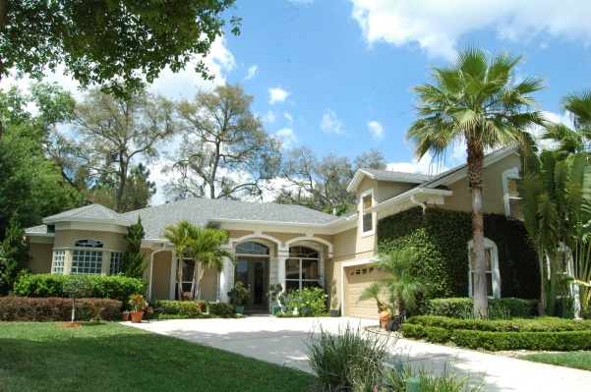
Upscale Home Marketing
UNIQUE HOMES MAGAZINE
DISTRIBUTED WORLDWIDE
FORTUNE 500 EXECUTIVES
ROLLS ROYCE OWNERS
FIRST CLASS AIRLINE SECTIONS
MANY MORE LOCATIONS

Slide 19
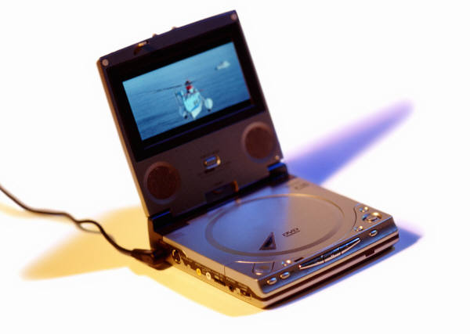
DVD’s for Marketing
FOR FSBO'S
PREPARING YOUR HOUSE TO SELL
PRICING YOUR HOUSE PROPERLY
PICKING THE RIGHT REALTOR
LISTING EXPIRED ? FIND OUT WHY

Slide 20
Don’t List with the Highest Bidder
Many agents will tell a homeowner that their property is worth much more than what it really is, just to get the listing or they just don’t have enough experience.
Choose a Realtor that reviews the recent sales and competition with you and has the tools and services to get your house sold

Slide 21
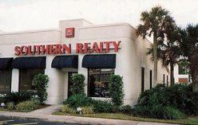
Let’s Get Started Now
SOUTHERN REALTY
ENTERPRISES,INC.
407-869-0033
1-800-771-0031
Multiple Offices to Serve You Better

